Slide 1
Delivery Drone Simulation
Submitted By -
Amit Tyagi
Muhammad Jahid Kabir
Shahana Yeasmin Bubly
Mohammad Abdul Bari Shabuj
Eikbal Hossain

Slide 2
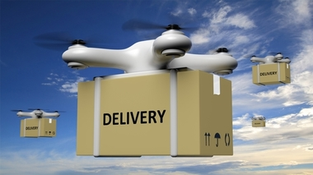
1. How many Drones needed?
2. How fast the drone travels?
3. How much weight can one drone carry (payload)?
4. How long the battery lasts?
5. Range of the coverage area?
User/Sponsor Requirements
source: google

Slide 3
1. Payload requirements: 200 kg per day
2. Packages: 200 units(parcels)
3. Maximum payload per trip : 05 kg
4. Coverage area : 35 km
5. Maximum trip time : 30 mins.
6. Maximum speed is 30 km per hour.
7. No. of drones required: 20
8. Battery charging time: 20 mins
9. Battery life: 1 hour
Objectives

Slide 4
1. Project Duration : 6 Months
a) Development- 4 months
b) Testing - 2 months
2. Risks -
a) Battery Life
b) Payload
c) Speed
d) Environmental Constraints (weather etc.)
3. Tools:
a) Open Source dev tools like Linux OS,
b) Programming Lang - Python
c) Code Repo - GitHub etc.
4. Output data report - Excel sheets etc.
Initial Planning

Slide 5
A sponsor i.e. DHL has the requirement to deliver 200 packages which weigh 200 kg. DHL requires 20 drones to deliver the payload. DHL offers service within the coverage area of 30 km. A smartphone app and GPS allow the customer to track their delivery.
Scenario

Slide 6
Conceptual Modeling

Slide 7
1. Number of drones taken 20
2. Speed of drone 30km/hr implemented
3. One drone will carry 05 kg weight (payload)
4. Battery lasts 1 hour expected
5. Maximum coverage 35 km implemented
Verification

Slide 8
Total 20 drones carry 200 kg payload, each carries 5kg, they fly 30km/hr, maximum coverage 35 km and delivered all the parcel.
Validation

Slide 9
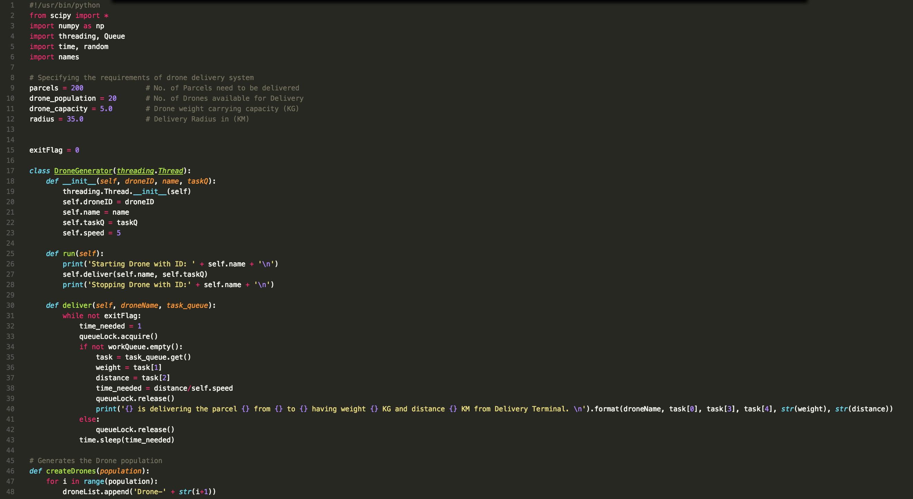
Implementation Code(1)

Slide 10
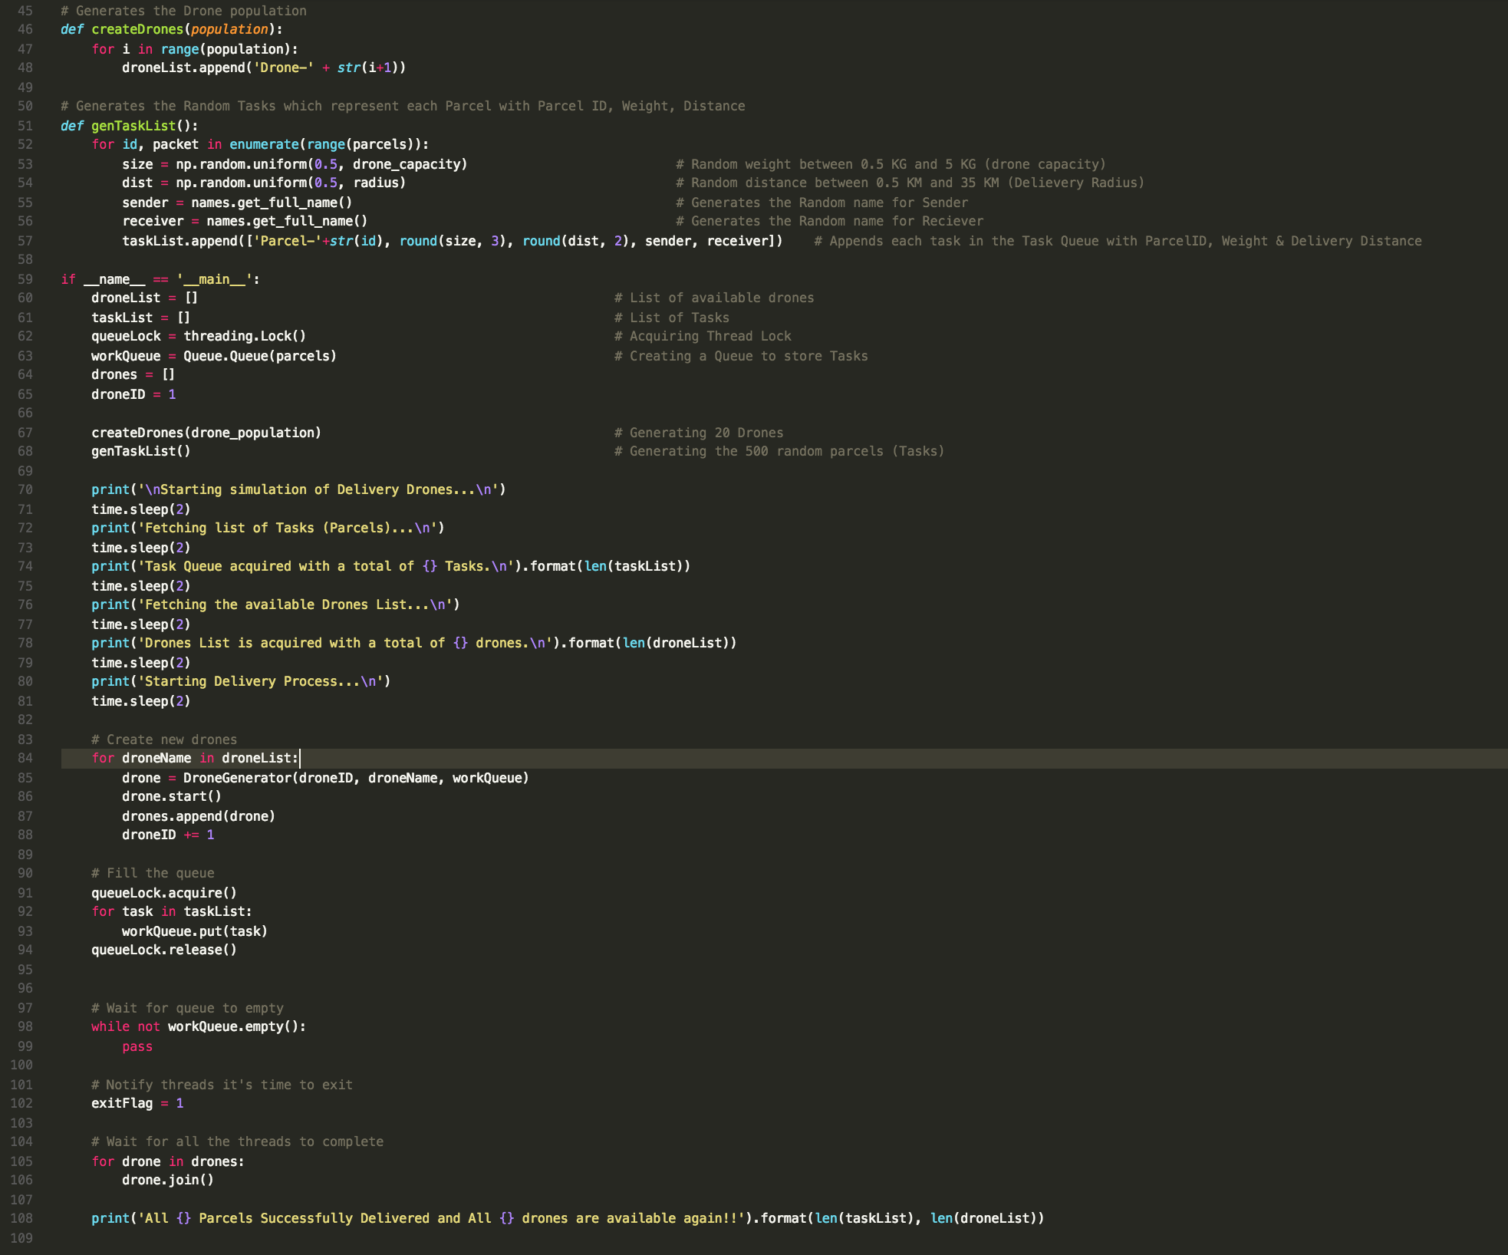
Implementation Code(2)

Slide 11
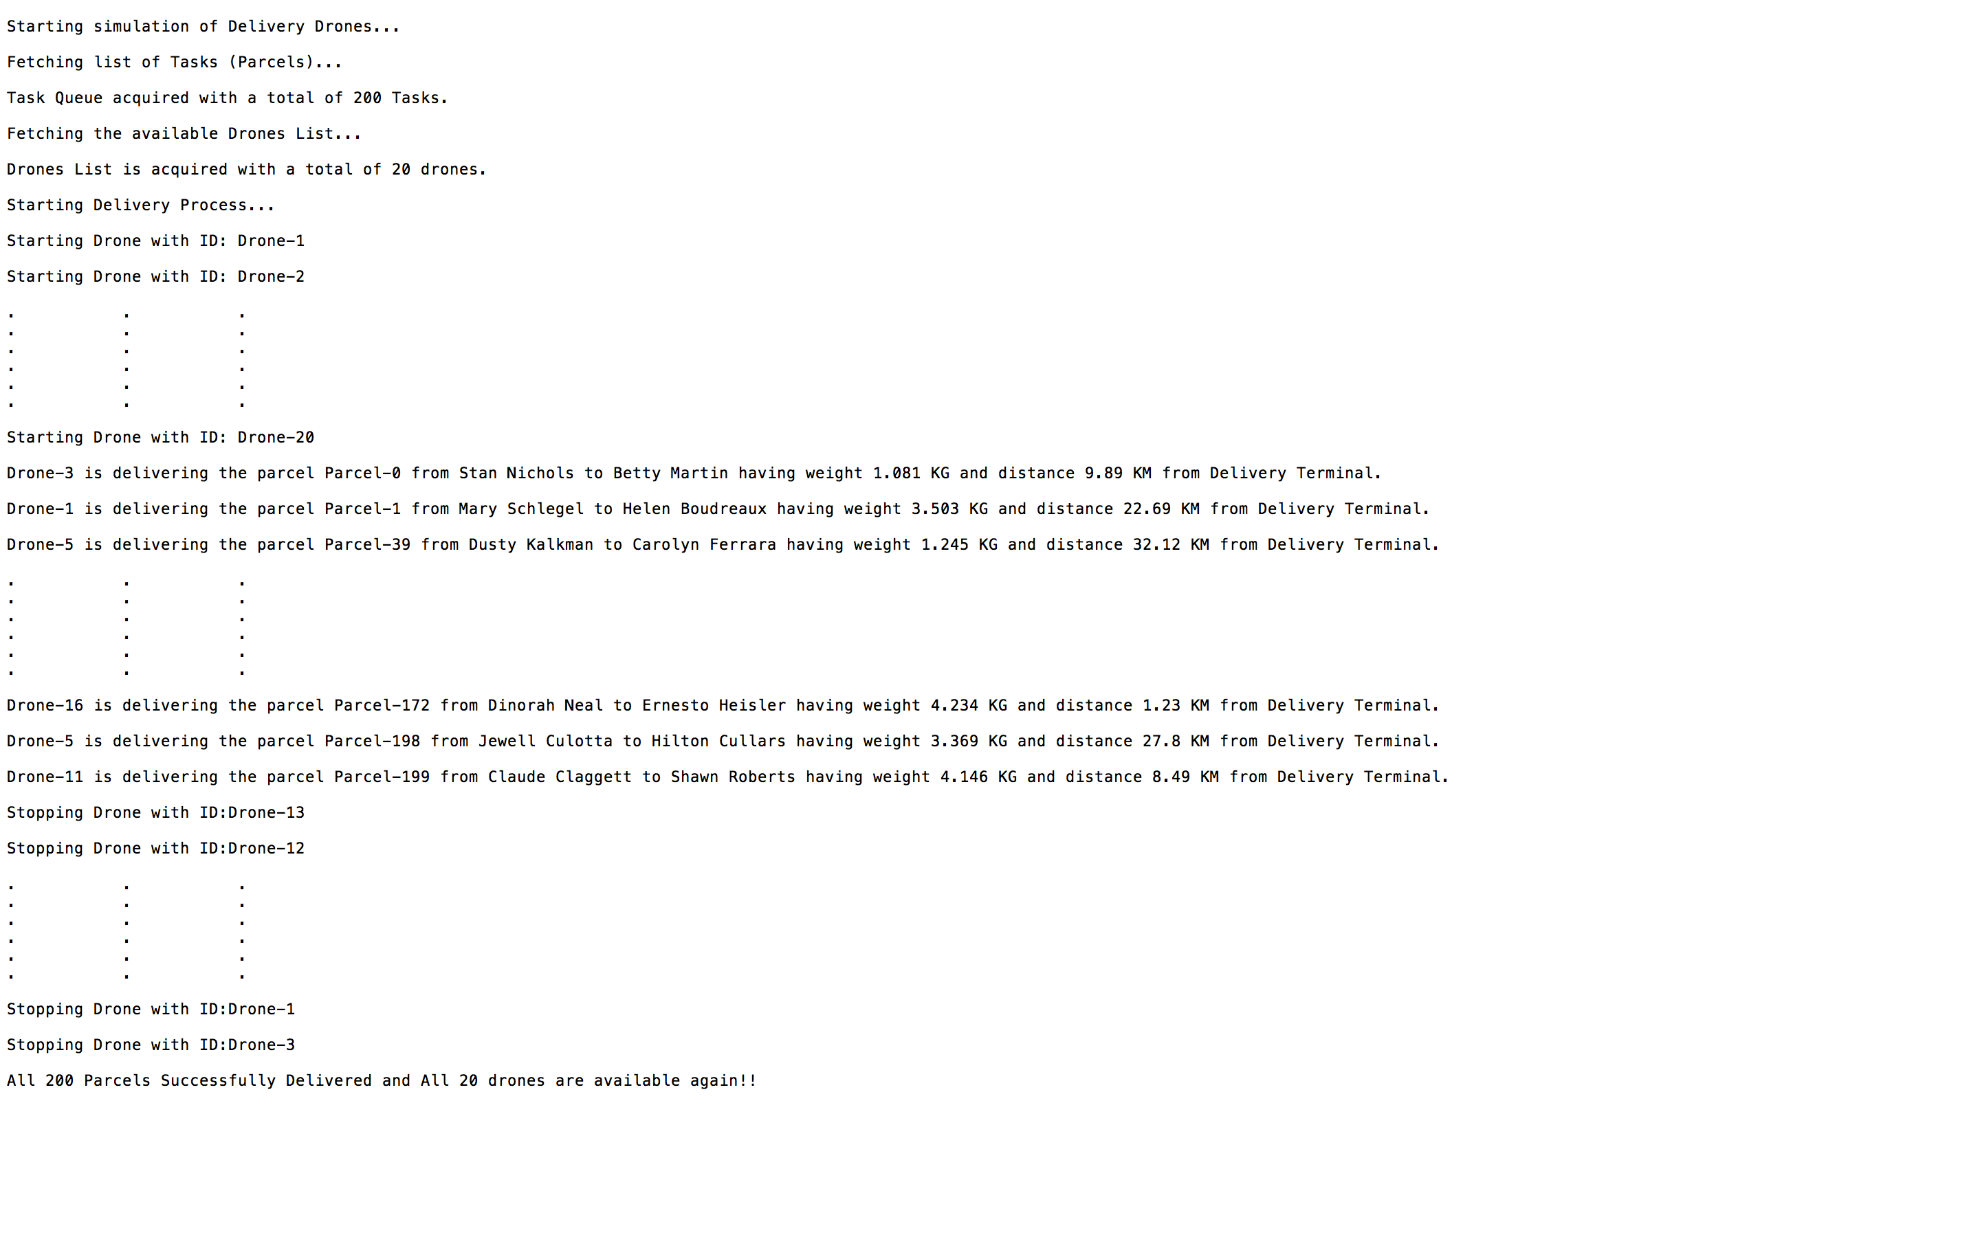
Results

